Slide 1
Classification of Illicit Activity over the Ethereum network using XGBoost
By Steven Farrugia
supervised by
Dr. George Azzopardi &
Dr. Joshua Ellul
Notes:
Hello, thank you for all being here. As expected we aren’t many so please feel free to stop me during the presentation with any questions you may have. I’d also like to thank my supervisors Dr. Azzopardi and Dr. Ellul for overseeing my work titled ‘Classification of illicit Activity over the Ethereum network using XGBoost’.
In brief we classify accounts (normal or illicit) on the Ethereum network based on their transaction history.

Slide 2

Colloquia Structure
1. Background
2. Our work
3. XGBoost classification model
4. Classification results & feature importance
5. Recommended future work & potential stakeholders
Notes:
Split into 4 main sections.
1. I’ll start off with necessary building blocks so as to help understand the research which will help lead to the motivation for our proposed research.
2. We then move to how we acquired the dataset necessary for us to analyse and pass to our classification model – XGBoost.

Slide 3

1. Background

Slide 4
1.1 Digital transactions & Blockchain

Slide 5


Digital transactions
- Digital economy is mostly reliant on trusted authorities.
- It is inadvertently causing us to trust that transactions have been truly fulfilled both securely and privately.

Slide 6

What is Blockchain technology?
Distributed consensus peer-to-peer network system (Source: Dannen, C)
Verification of transactions by majority of entities over the network
Public ledger of all transactions
Immutable through cryptographic hash functions and the consensus algorithm (append only structure) (Source: Ammous, S)
Instills end users with a sense of trust in the system enforced by public/private keys
NO THIRD-PARTY HUMAN INTERVENTION
Notes:
this may be circumvented in the event that an individual or group of individuals has the majority control (over50%) of the network. If this is not the case, the provided ledger is deemed to be both a historical and reconciliated rendition of the ground truth.

Slide 7
Benefits of Blockchain technology
Algorithm (Smart contract) deployment ON Blockchain technology to fulfil business processes or other potential CaseS
(Source: Clack, C).
Facilitates digital payments between entities in a trustworthy and secure manner.
stores all records and assets in the form of an immutable database
(Source: Ammous, S)

Slide 8
1.2 Ethereum

Slide 9


Ethereum
Launched in 2015 by Vitalik Buterin.
Intent of serving and addressing several limitations present in Bitcoin.
Offers full Turing completeness - > smart contracts.
Ether is its digital currency.

Slide 10

Ethereum internals
Ethereum state is composed of objects known as accounts.
State transitions are defined by the direct transmission of digital value and information between accounts.
Merkle Patricia Tree structure is used to store all key-value pairs in Ethereum domain.

Slide 11

Ethereum accounts
Externally Owned Account (EOA) and Contract Account (CA).
Each account has a 20-byte address
Each account contains the following four fields:
Ether balance;
Nonce;
Contract code hash; and
Storage.
Notes:
Storage – hash of the ID of the root storage trie

Slide 12
Ethereum and Bitcoin messages
Ethereum | Bitcoin
Messages may be created by EOA or CA | External accounts only
Possess specific field for data | No field for data
CA may respond through a predefined function | No functions may be executed

Slide 13

Why Ethereum?
Has the 2nd largest cryptocurrency market share.
Largest number of active developers between January 2018 and February 2019.
Most used platform.
Leading smart contract platform.
Exhibits a high potential for future growth.

Slide 14
1.3 Illegal digital activities

Slide 15
Traditional illicit activities
Banks and corporations have invested heavily in anomaly transaction detection systems.
This issue is present on a global scale.
Money laundering, fraud, crime phishing etc.
Notes:
Some banks had to close up after they were unable to carry out the necessary procedures as well as inform the relevant authorities

Slide 16

Global economic crime
Over 49% of 7,200 companies victim of fraud in 2018 (PwC) – (Source: https://www.pwc.com/gx/en/forensics/global-economic-crime-and-fraud-survey-2018.pdf) .
$21.84 billion in credit card fraud in 2015.
Credit card fraud is expected to exceed $32 billion by 2020.
20% of clients join another bank after being a victim of fraud (Source: Miller, P).
Notes:
Add sources

Slide 17
Anomalous transactions on Ethereum
Similar activity is present on Ethereum.
Anonymity helps hide illicit intentions.
No tools in place to flag or detect suspicious activity.

Slide 18
Types of illegal activity on Ethereum
Smart contract Ponzi schemes
Fraud
Phishing
Money mixing

Slide 19
What are Smart Ponzi schemes and why are they so attractive?
Anonymity
Unstoppable
False sense of trustworthiness

Slide 20
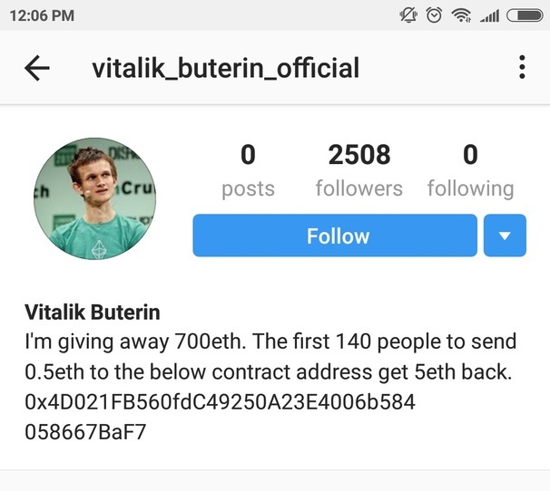
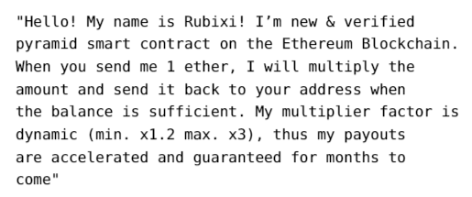
Examples of scams
Source: “https://securelist.com/spam-and-phishing-in-q2-2018/87368/”

Slide 21
1.4 Reviewing transactions and Big Data

Slide 22
Manual review of transactions
Still widely adopted practice for the detection of fraud.
In 2017 CyberSource reported that 79% of North American businesses conduct ad-hoc manual reviews while only 25% manually review all executed orders. Of these 25%, 89% are then formally accepted by the respective businesses.
Waste of time, money and resources.

Slide 23
Traditional transactions
150 million transactions were processed per day by Visa– 1,667 transactions per second in 2017¹
Mobile payments through developed mobile wallets processed $194.1 billion in 2016²
¹ Jan Vermulen. “Bitcoin and Ethereum vs Visa and PayPal – Transactions per second.2017”.url:https://mybroadband.co.za/news/-
banking/206742-bitcoin-and-ethereum-vs-visa-and-paypal-transactions-per-second.html.
² Al Pascual, Kyle Marchini, and Sarah Miller.2016Identity Fraud:Fraud Hits an Inflection Point.2016.url:https://www.javelinstrategy.com / coverage - area / 2016 - identity - fraud - fraud - hits -inflection-point

Slide 24

Cryptocurrency as Big Data
Velocity, Volume and Variety (3 Vs) (Source: Laney, D)
Help in revolutionizing business operations in various industries.
Data management, quality and security issues.
Bitcoin has circa 210GB from inception till April 2019.
Ethereum has circa 140GB from inception till March 2019.
Security issues will be suppressed by blockchain technology.

Slide 25

And hence the need for machine learning…

Slide 26
1.5 Similar research

Slide 27
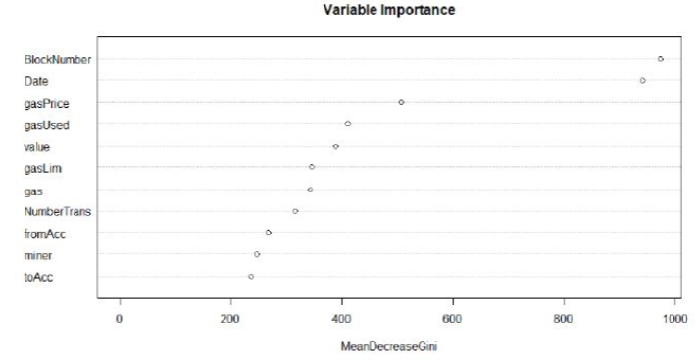
Detecting Patterns in the Ethereum Transactional Data using Unsupervised Learning
4000 scam transactions combined with 10 million normal transactions were gathered from Etherscamdb and a Ethereum node, respectively.
Random Forest was used to determine most important features.
13 clusters produced max Davies-Bouldin Index of 81.2%.
5 outliers pertaining to transactions detected.
Having maximum Euclidean distance from centres.
Eibhlín O’Kane. “Detecting Patterns in the Ethereum Transactional Data using Unsupervised Learning.” In: (2018)

Slide 28
Understanding Ethereum via graph analysis
45,261,952 transactions (2,721,080 accounts) were gathered from inception till 10th June 2017 on Ethereum
The following three graphs were used to gain insights pertaining to each of the account’s interactions/transaction history:
Money flow graph;
Smart contract creation; and
Smart contract invocation.
Two classifiers working together:
Features extracted from the graphs (in-degree, out-degree, etc.) returning Boolean if any of the predefined 3 thresholds are surpassed.
Another script detecting accounts as abnormal – deemed so by the number of created smart contract accounts rarely used for money transfer or invocation.
Account created over 40,000 smart contracts in a short period of time
Ting Chen, Yuxiao Zhu, Zihao Li, Jiachi Chen, Xiaoqi Li, Xi-apu Luo, Xiaodong Lin, and Xiaosong Zhange.
“Understanding ethereum via graph analysis.” In:IEEE INFOCOM2018-IEEEConference on Computer Communications. IEEE.2018, pp.1484–1492.

Slide 29
Insights
Users prefer transmitting money on Ethereum as opposed to smart contracts.
Smart contracts are not commonly used in Ethereum domain.
Variability in Ethereum usage suggests it is also being used for testing and deployment of toy contracts.
Notes:
Mainly due to users prior experience in other cryptos and lack of use in smart contracts
Lack of applications converted and implemented

Slide 30

2. Our Work

Slide 31
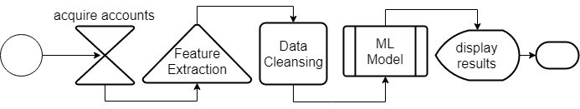
Proposed solution

Slide 32
2.1 Accounts

Slide 33
Normal accounts
Acquired from the Ethereum mainnet.
Hosted Infura node vs. local GETH client node.
Circa 5,000 blocks were downloaded during a period of interest (mid-2017).
Between 50-150 transactions per block.
3,000 accounts were then randomly selected from these blocks.

Slide 34
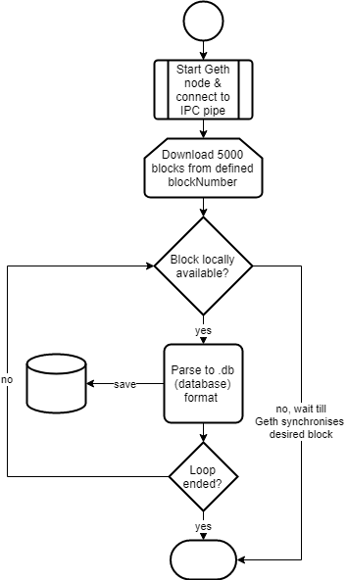

Slide 35
Illicit accounts
2,179 unique illicit accounts – Up until 17th April 2019.
Obtained from Etherscamdb - MyCrypto team together with the Ethereum community.
These accounts were flagged as illicit for the following reasons:
Imitating contract addresses providing tokens.
Scam lotteries.
Imitating other users.
Fake ICOs.
Ponzi schemes.
Phishing.
Mirroring websites.

Slide 36
2.2 Transactions

Slide 37

Obtaining the respective account transactions
Etherscan API allows for the retrieval of transactions for each account ID provided
Limitations:
Maximum of 10,000 transactions may be retrieved per account.
Retrieval time ranges between 1 and 25 seconds per account.

Slide 38
Transaction types
1. Normal transactions
2. ERC20 transactions

Slide 39
Normal transactions
Easiest form of transactions between EOAs.
When claiming tokens value is 0.
Some fields of interest:
ISERROR
STATUS
TO
FROM
VALUE
TIMESTAMP

Slide 40
ERC20 transactions
Solely related to the transfer of tokens supporting the ERC20 interface standard.
All transactions are successfully if listed.
JSON Format.

Slide 41
2.3 Feature extraction

Slide 42

Feature extraction
42 features were extracted per account.
Some extracted features include;
Average time between transactions
Minimum value received
Unique accounts with which an account interacted with
Time between first and last transaction
Minimum value sent
Total number of transactions

Slide 43
2.4 Understanding the created dataset

Slide 44
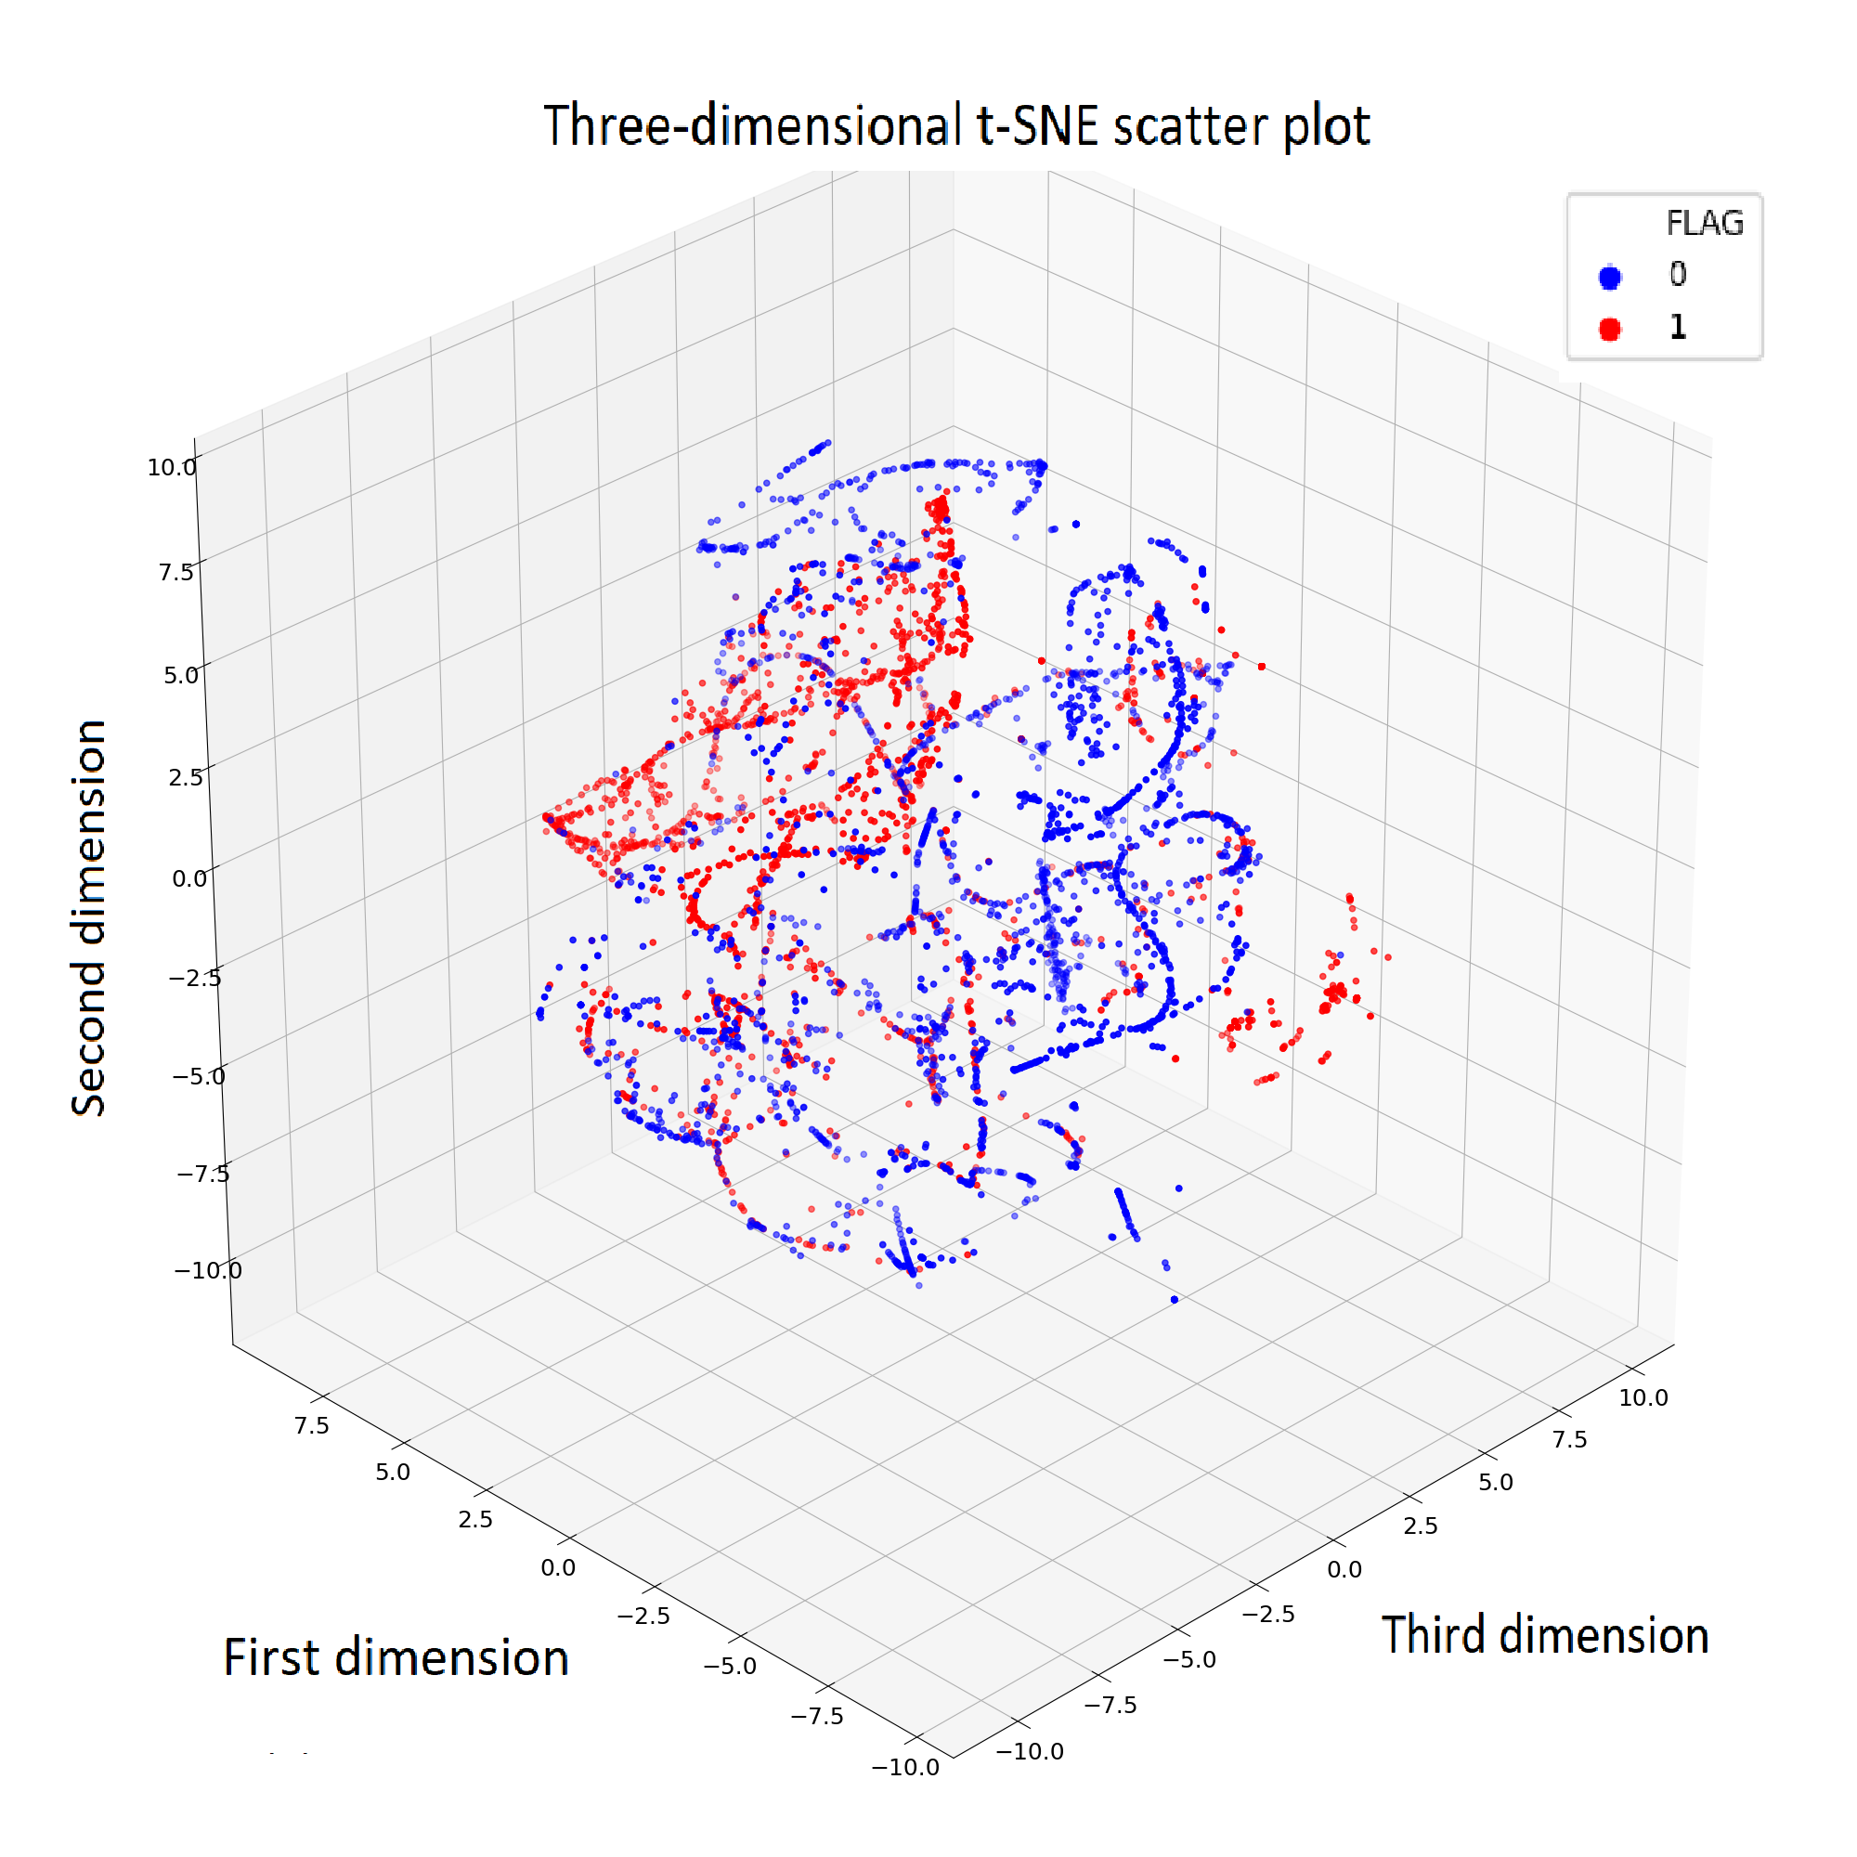
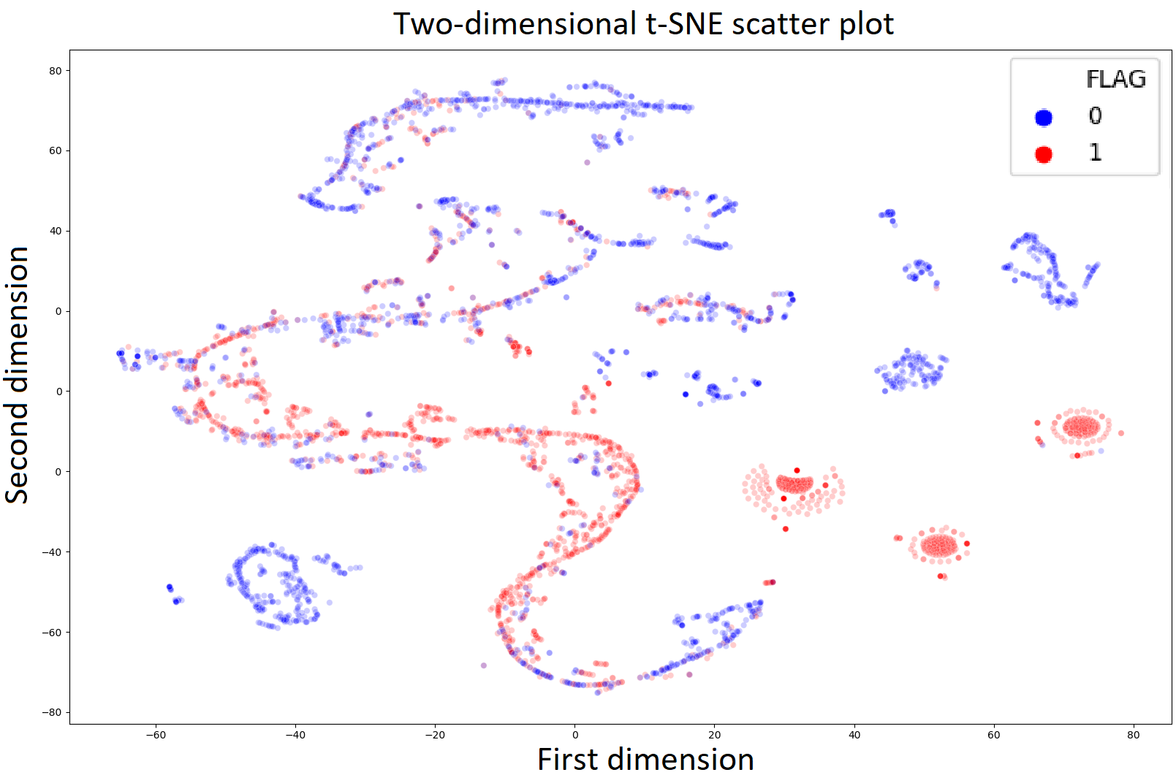
T-SNE visualization

Slide 45
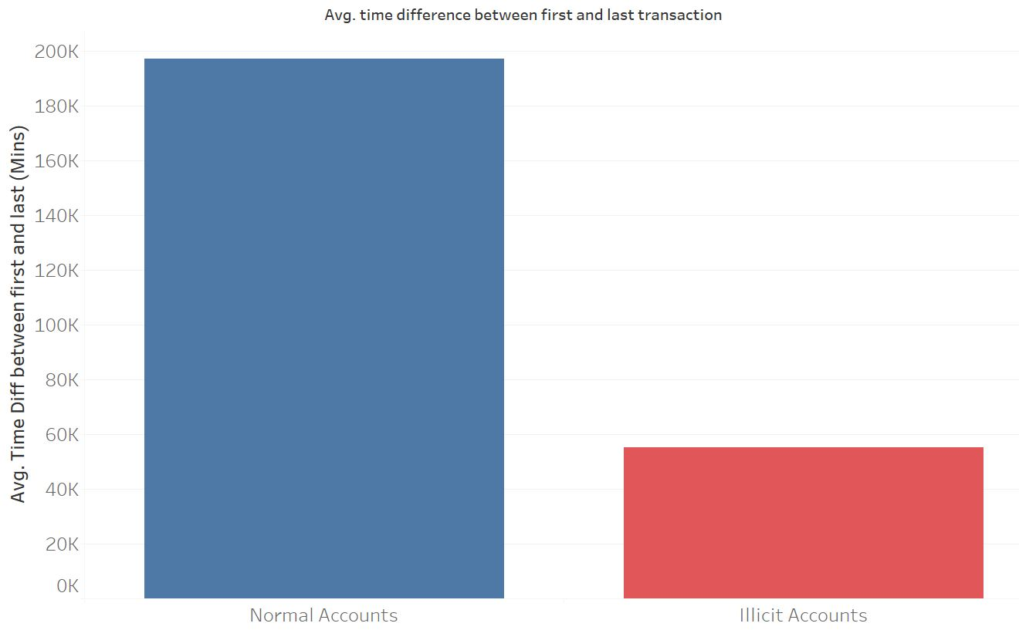
General dataset information

Slide 46
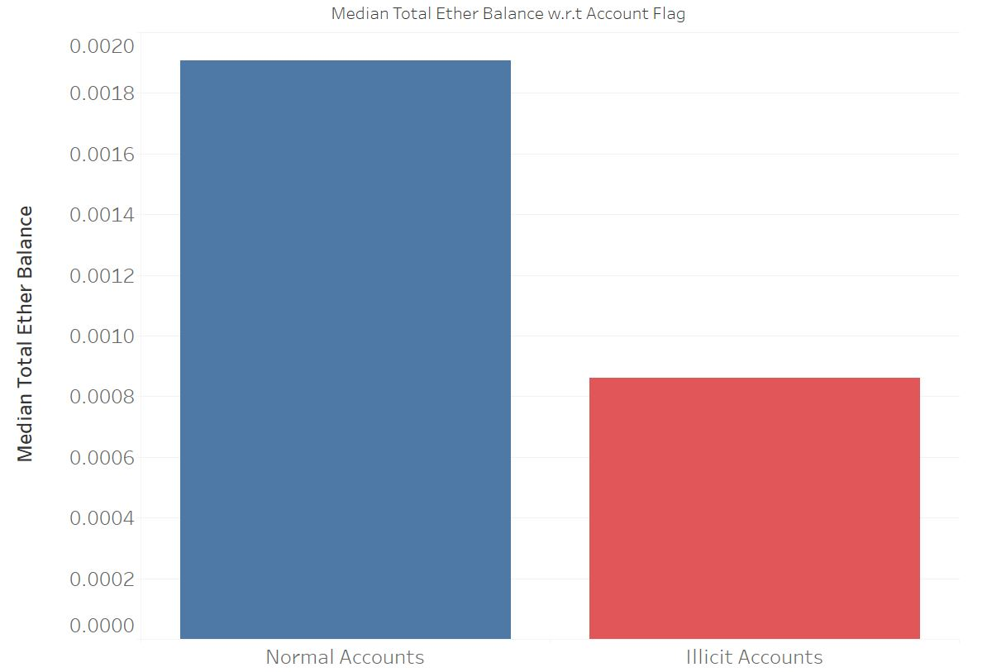
General dataset information

Slide 47
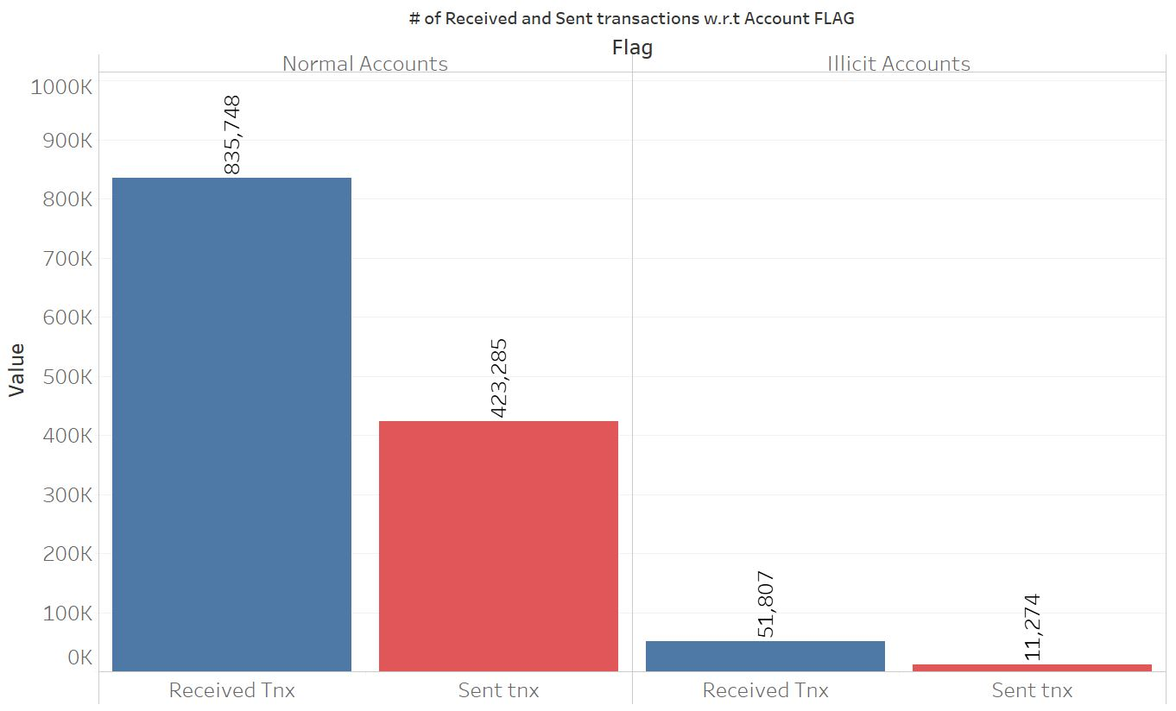
General dataset information

Slide 48

3. XGBoost classification model

Slide 49
XGBoost
1. Decision tree
2. Bootstrap Aggregating (Bagging)
3. Random Forest
4. Boosting
5. Gradient Boosting
6. XGboost
Notes:
Decision tree on steroids

Slide 50
1. Decision tree
Assigns a probability value to each decision – decision-making device.
Using an elements history to determine the future outcome.
Divides the input space into disparate regions.
Assign a constant basis function to each region.
Root node to leaf node through a series of binary questions.

Slide 51
2. Bootstrap Aggregating (Bagging)
Generates diverse training sets.
Sampling with replacement.
Ensemble of classifiers generated.
Final classifiers aggregates output of the classifiers - > ‘voting scheme’.

Slide 52
3. Random Forest
Adds a layer of randomness.
Bootstrap random subset of available features.
Counteracts issues such as overfitting.

Slide 53
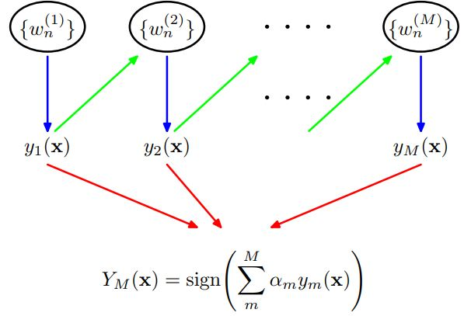
4. Boosting
Training multiple base classifiers in a sequential manner.
Error function depends on performance of all previous models in the ‘chain’.
Instances misclassified by previous classifier are assigned more weight.
Notes:
Adaboost – Adaptive boost implements this

Slide 54

5. Gradient Boosting
Implementation of Gradient boosting algorithms.
The given loss function seeks to minimize the overall error.
Tweak in the direction of the descending gradient.
Number of parameters to help to overcome local minima & plateaus.

Slide 55
6. XGBoost
System benefits:
Parallelization
Tree pruning
Hardware optimization
Algorithm enhancements:
Regularization
Cross-validation

Slide 56

4. Classification results & feature importance

Slide 57
4.1 XGBoost training and classification results

Slide 58
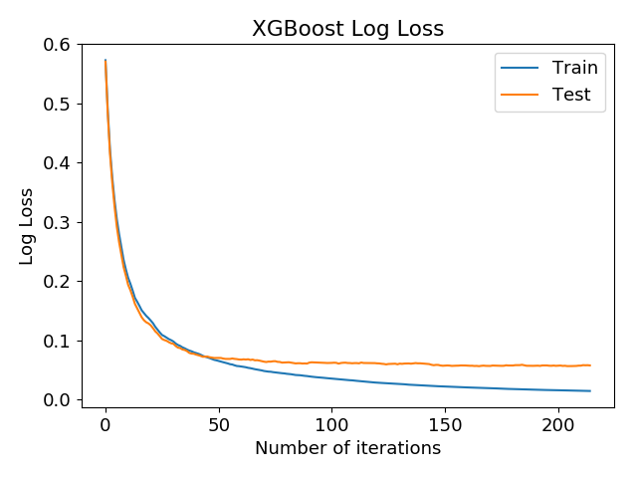
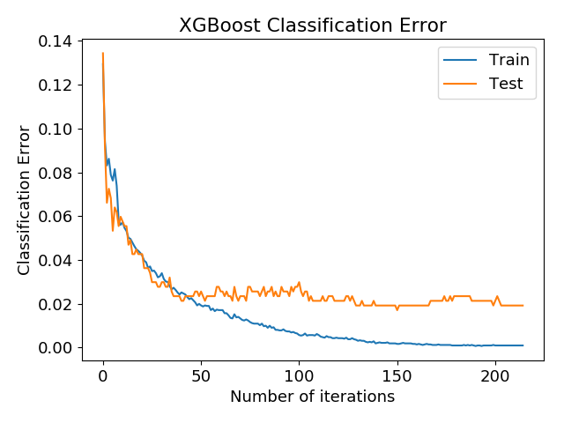
XGBoost

Slide 59
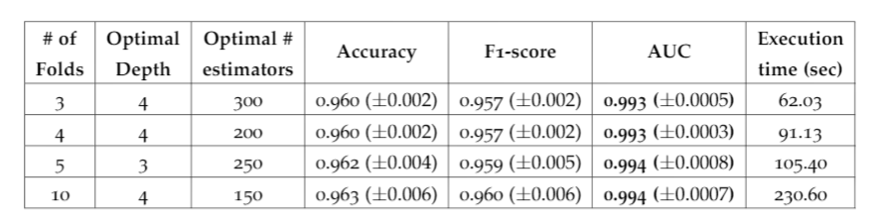
XGBoost –cross-validation results
Notes:
Precision = TP / TP + FP
Recall = TP / TP + FN
F1-score = Harmonic mean of precision and recall ( 2 * (Precision * Recall) / Precision + Recall)
AUC = TPR vs. FPR. Measures separability/distinguishability between two classes.

Slide 60
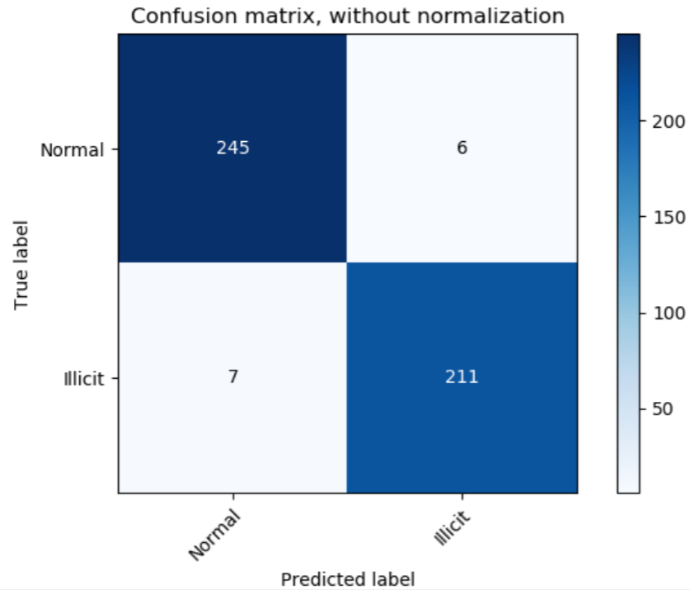
Confusion matrix
Notes:
FP = 6
FN = 7 – MOST IMPORTANT

Slide 61
4.2 False Negatives and False Positives

Slide 62
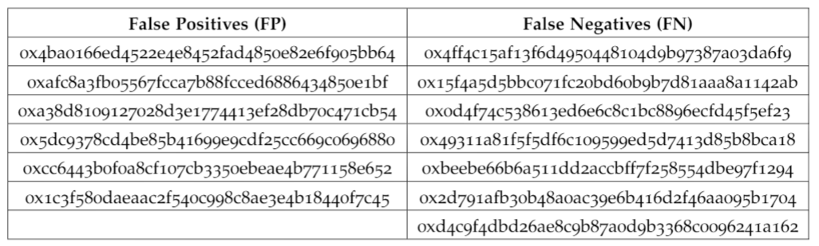
False Positives / False Negatives
Over 1 of 10-fold cross-validation results

Slide 63
Looking further …
Account ID: 4c15af13F6D4950448104D9B97387A03dA6f9
Account was active for a period of 3 hours in total, carrying out 5 transactions; 3 incoming and 2 outgoing on the 25th of September 2018. All transactions were sent to or received from unique addresses. Account shows signs of an externally owned account (EOA).

Slide 64
And another …
Account ID: 0x15f4a5d5bbc071fc20bd60b9b7d81aaa8a1142ab
Account was said to be a phishing scam for a startup called OneLedger. The account was active for 53 days between 8th February, 2018 and 3rd April starting off with an Ether balance of 0.8. 7 Transactions were executed in total; with 2 incoming and 5 outgoing transfers. All transactions interacted with unique account addresses.

Slide 65
4.3 Feature importance

Slide 66
Feature Importance parameters
Weight
Weight
Cover
Gain
Notes:
Gain – improvement in accuracy gained by a feature after its split on
Weight – number of times a feature occurs in the trees
Coverage – Number of times feature used to decide the leaf node

Slide 67
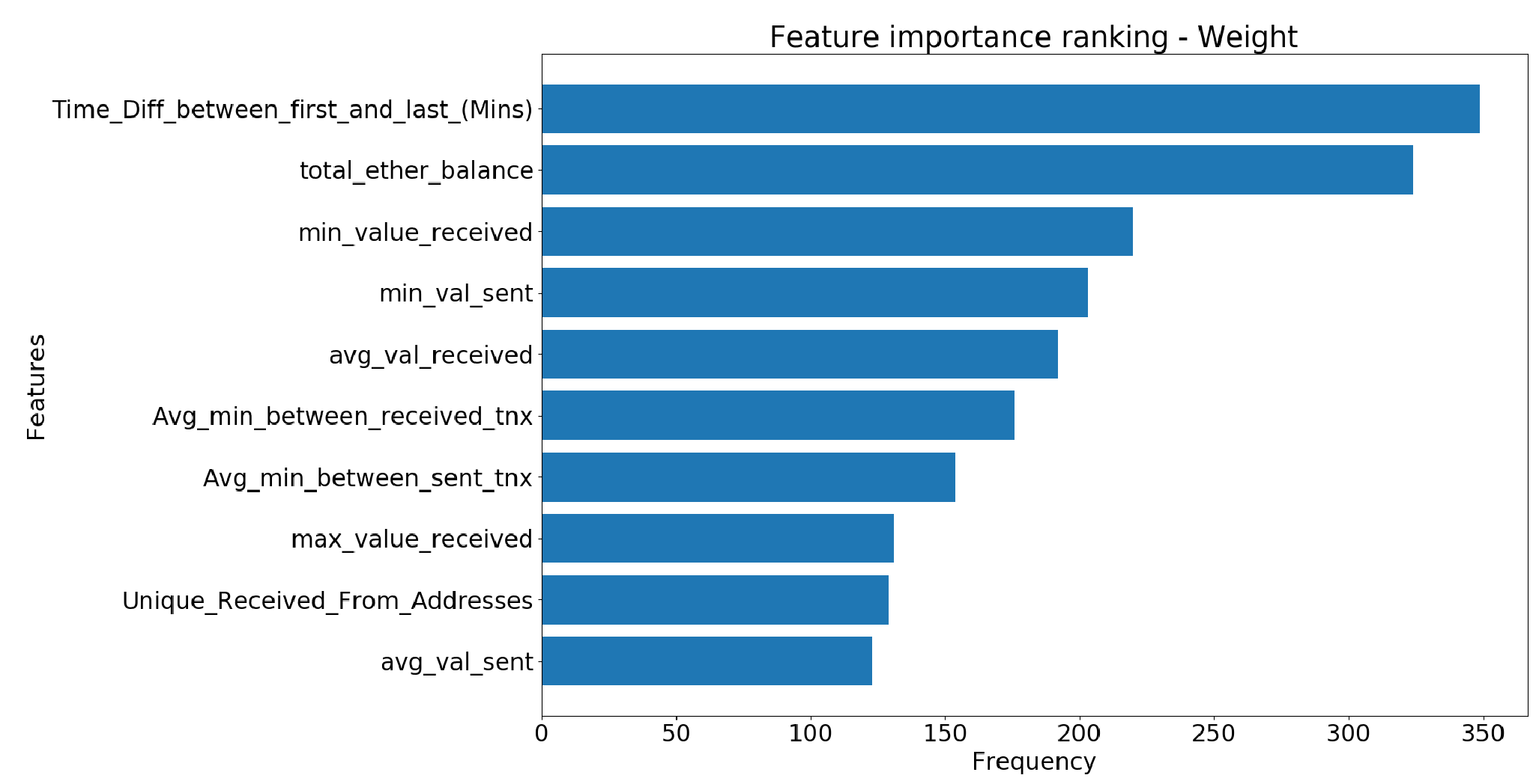
Feature importance – ‘Weight’

Slide 68

5. Recommended future work & potential stakeholders

Slide 69

Recommended future work
Adapt our proposed approach to other blockchain networks
Classify at a ‘transaction level’
Look into other features which may be extracted and improve classification results
Look into graph analysis

Slide 70
Potential Stakeholders
Government entities
Developers, researchers and news agencies
Private entities/corporations

Slide 71

Thank you !

Slide 72

Questions?

